Slide 1


6. Advanced Visualization
Mrinal Vashisth
PhD Year 2, Computational Psychometrics, TSU, RF
M.Sc. Human Development: Genetics, Neuroscience and Psychology, TSU, RF
M.S. Applied Mathematics and Information Technology (Systems Biology and Bioinformatics), ITMO, RF
B.Tech. Biotechnology, JNU, RI

Slide 2
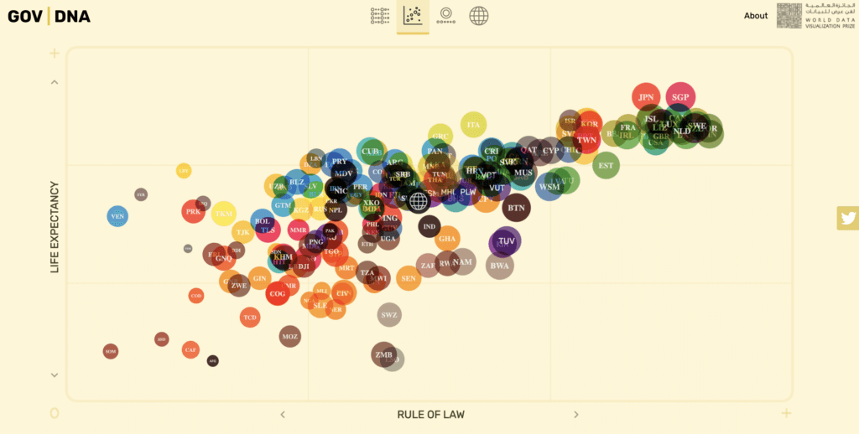
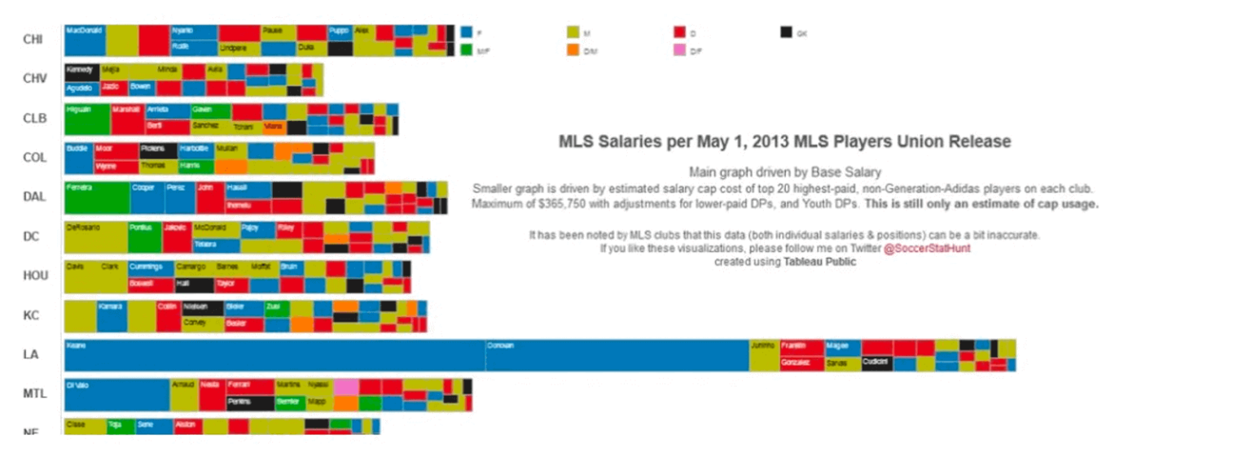
Images tell stories, and also distort them
Examples of plotting badly
Using the wrong graphs or charts for a particular purpose [1]
Make better use of colors. [1]
Creating misleading graphs or charts [1]
Incorporating too much information in one graph [1]
[1] https://ninjatables.com/bad-data-visualization-examples/

Slide 3
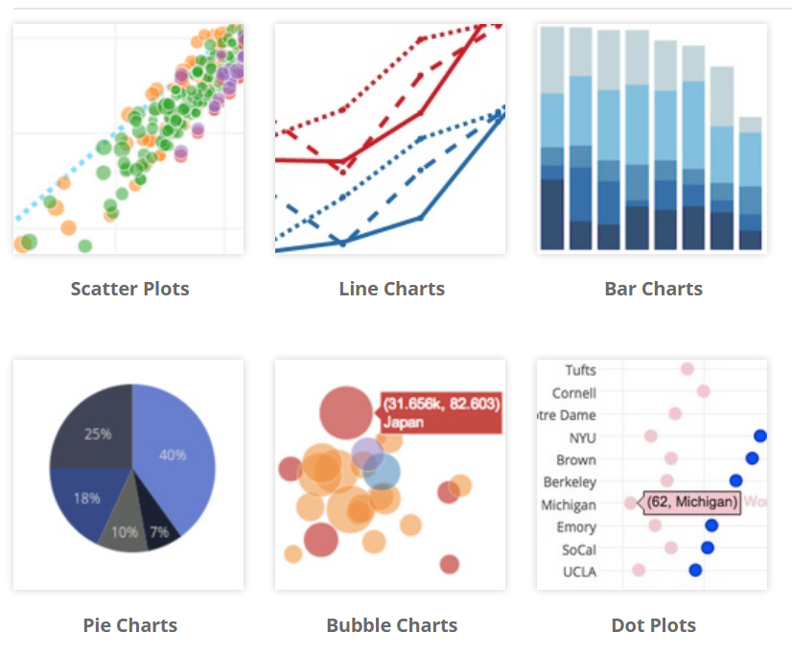
Types of graphs
https://plotly.com/python/
https://plotly.com/graphing-libraries/
https://python-graph-gallery.com/

Slide 4
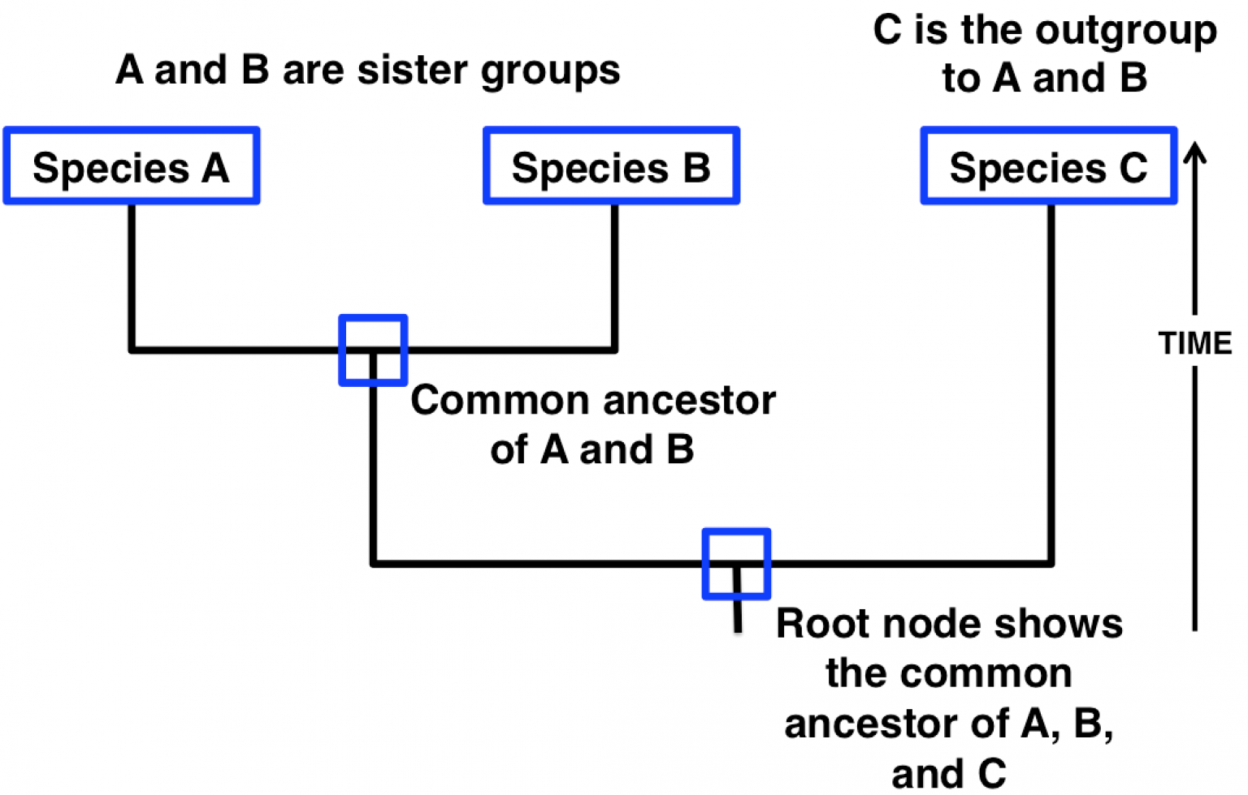
Tree thinking
https://bio1220.biosci.gatech.edu/life-birth-or-formation-of-biological-systems/how-do-we-know-about-the-history-life-on-earth/

Slide 5
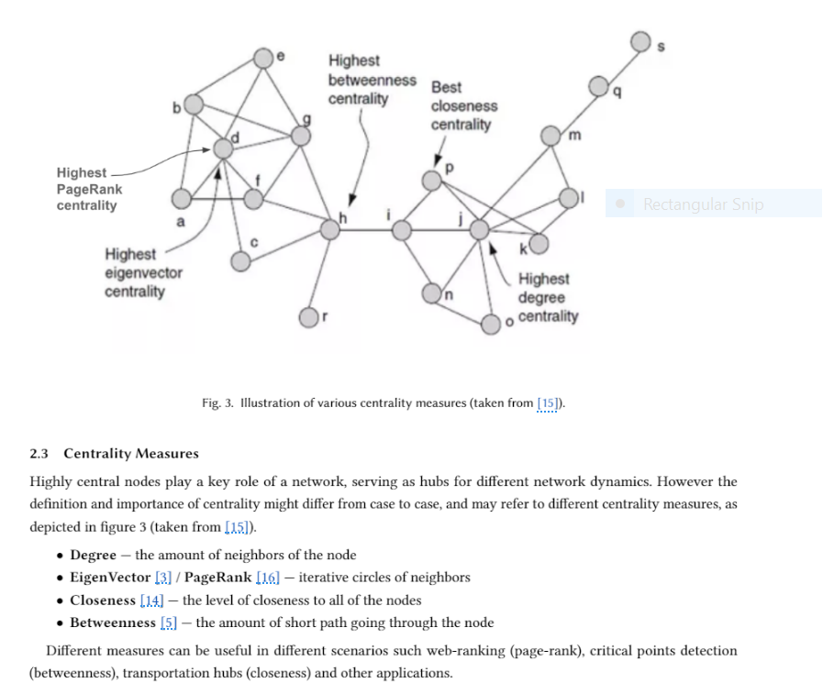
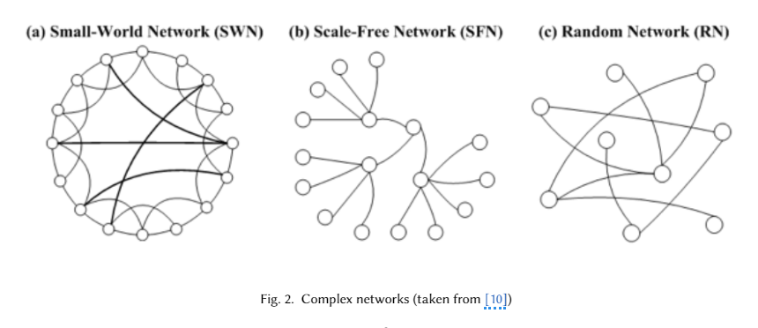
Network thinking
https://www.semanticscholar.org/reader/751ad2037eed704898b098e36ddf0a9f250a56a1

Slide 6
Assignment
Filter the final_df dataframe (the one we used to make the network plots) for joint probability greater than 10%. [1]
Plot the network, subsequently the sankey and cluster dendrogram of the data.
Finally, create a line plot with p1, p2, and p1p2. Optional: Make a vertical line on this plot that says top 10th percentile for p1p2.[2]
Hint [1]: Search for 'how to filter a dataframe by column values'
Hint [2]: https://plotly.com/python/line-charts/
Describe the obtained results in a few lines, and submit your plots as html files and jupyter notebook into your assignment folders for this session.

